Slide 1
Standardization development Status and progress
CEN TC 10 (Lifts, escalators and moving walks)
Esfandiar Gharibaan
Chairman CEN/TC 10
International Lift Expo Korea
14th September 2021

Slide 2
1
CEN/TC 10 work program
2
Worldwide convergence of technical requirements for safety of lifts
3
EN ISO 8100-1/2
4
ISO/TC 178 work program

Slide 3
CEN/TC 10 work program

Slide 4
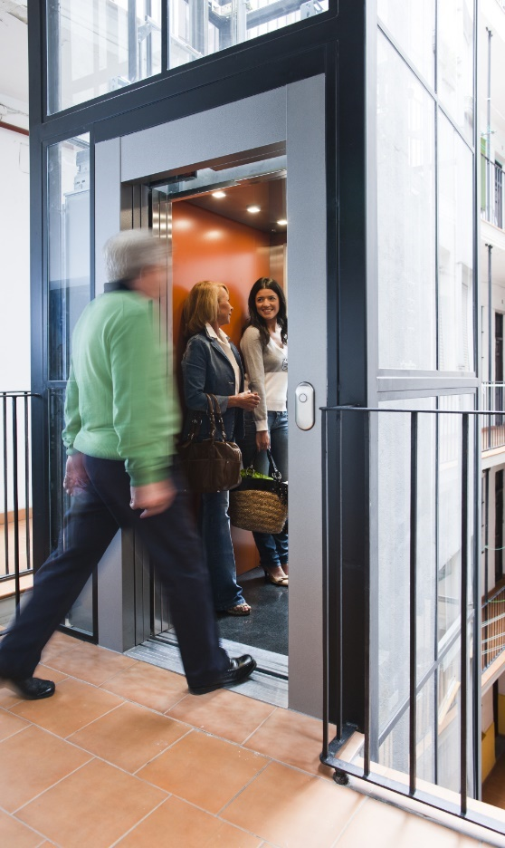
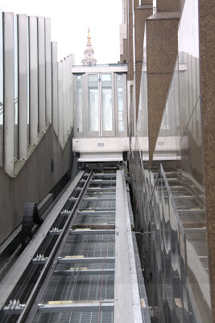
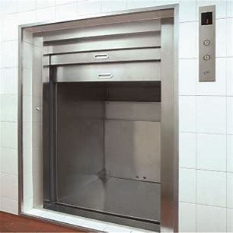
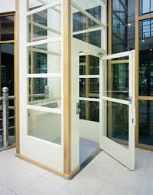
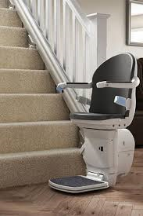
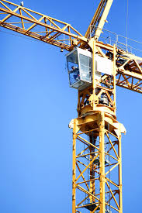
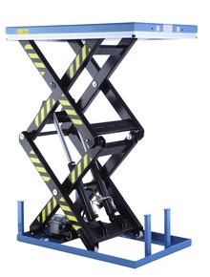
CEN/TC 10 work program General overview
Lifts
Inclined lifts
Escalators
Building Hoists
Supporting
documents
EN 81-28
EN 81-50
EN ISO 8100-2
EN 81-58
prCEN/TS 81-60
EN 81-70
EN 81-71
EN 81-72
EN 81-73
EN 81-76
EN 81-77
EN 81-80
EN 81-82
CEN/TS 81-83
EN 12015
EN 12016
EN 12385-3
EN 12385-5
EN 13411-7
EN ISO 25745-1
EN ISO 25745-2
EN 12385-3
EN 12385-5
EN 13411-7
EN 81-22
EN 115-1
CEN/TR 115-3
CEN/TS 115-4
EN 115-2
prEN 115-5
EN 13015
EN ISO 25745-1
EN ISO 25745-3
EN 12158-1
EN 12158-2
EN 12159
prEN 16179
CEN/TR 81-10
EN ISO 14798
By
CEN/TC 168
CEN/TS 81-11
CEN/TR 81-12
prCEN/TS 81-13
EN 81-20
EN ISO 8100-1
EN 81-21
Goods only lifts
Lifting Platforms
Stairlifts
Lifts in Cranes
Lifts in Wind Turbines
Lifting Tables
EN 81-3
EN 81-31
EN 81-41
prEN 81-42
prEN 81-45
prEN 81-46
EN 81-40
EN 81-43
prEN 81-44
EN 1570-2
Red marked are European harmonized standards.

Slide 5
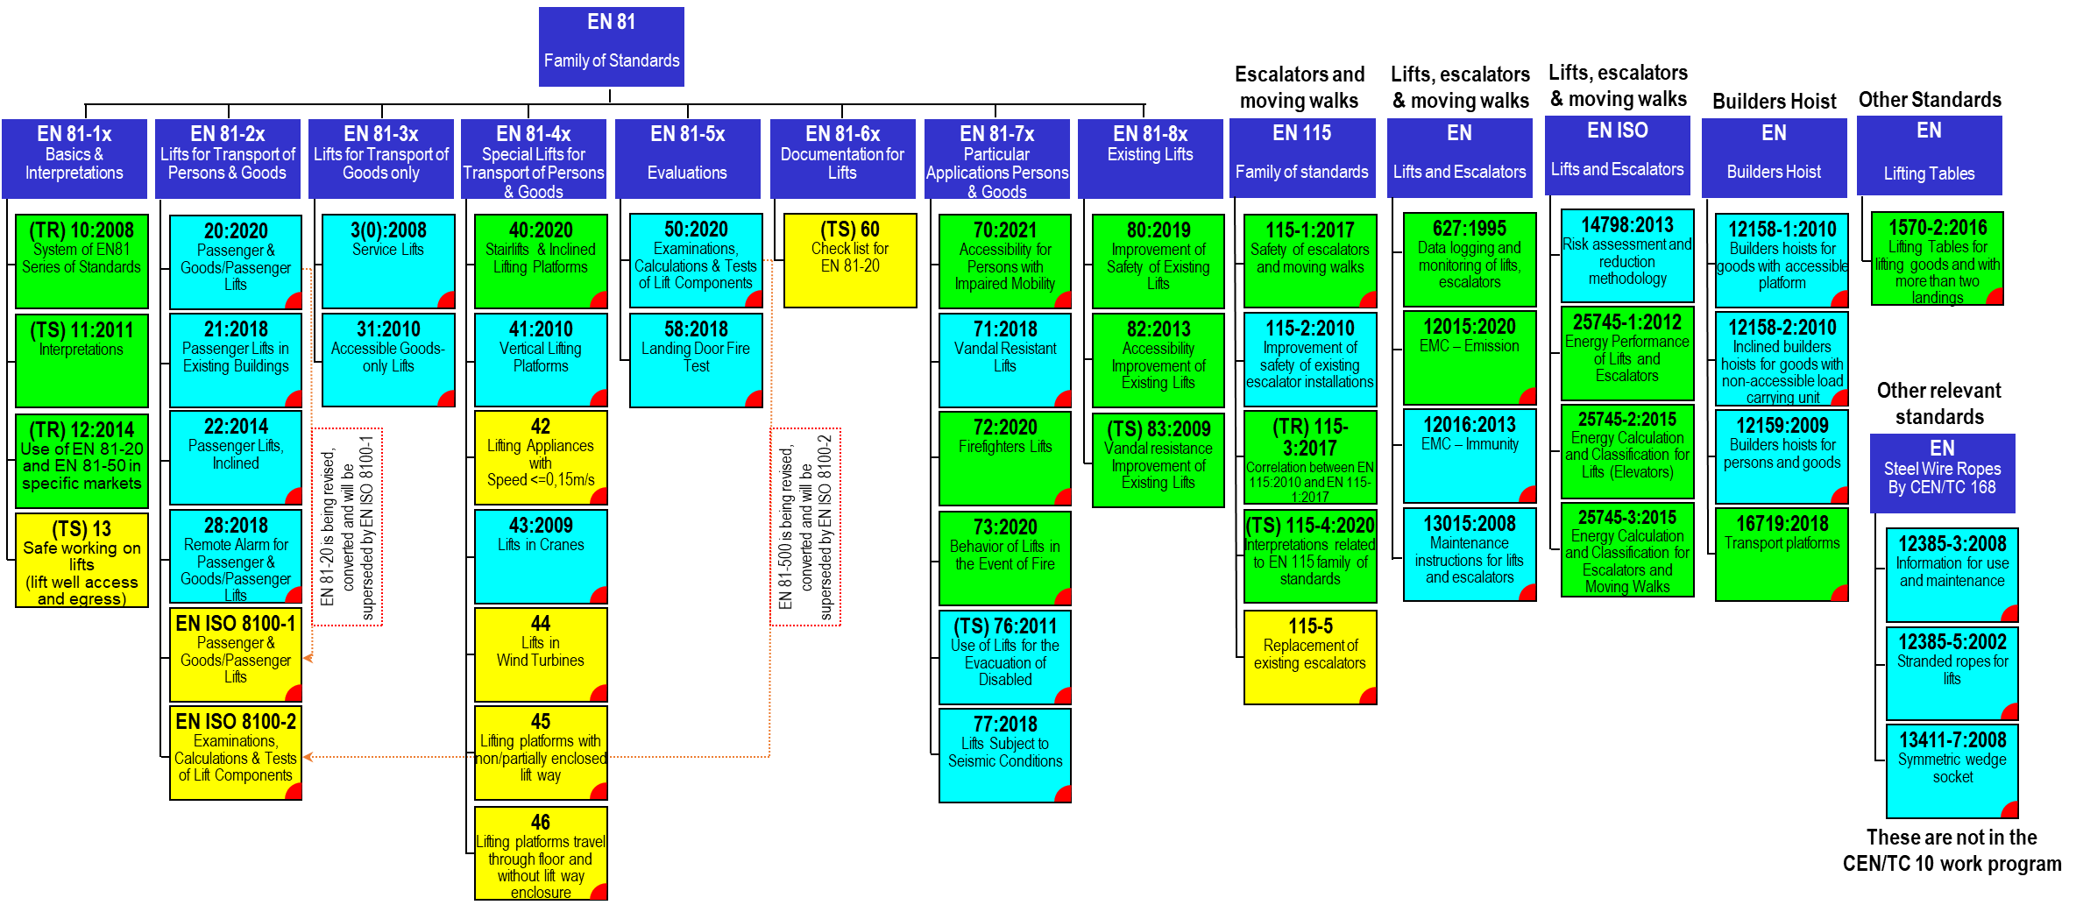
CEN/TC 10 work program General overview
Legend:
Published (year of the latest edition)
Under revision
In development
Harmonised standards
Lifts Directive: 16
Machinery Directive: 18
EMC Directive: 2
In preparation for development
European Harmonised Standard
Total of 49 standards, 40 published and 9 in development

Slide 6
CEN/TC 10 work program Main projects
EN ISO 8100-1/2
Combined revision of EN 81-20/50:2020 and ISO 8100-1/2
New standards
CEN/TS 81-13: Safe access to the lift well for lifts in service
EN 81-42: Vertical lifting appliance with enclosed carrier intended for use by persons, including persons with disability
EN 81-44: Lifts in wind turbines
EN 81-45: Lifting platforms with non/partially enclosed lift way
EN 81-46: Lifting platforms travel through floor and without lift way enclosure
CEN/TS 81-60: Specification for means of determining compliance with EN 81– 20
EN 115-5: Replacement of existing escalators
Revision of standards
20 standards under revision

Slide 7
Worldwide convergence of technical requirements for safety of lifts

Slide 8
Worldwide convergence of technical requirements for safety of lifts Cooperation between ISO and CEN (Vienna Agreement)
ISO & CEN agreement on technical cooperation
Avoiding duplication of work between ISO & CEN
Modes of cooperation
Correspondence
Mutual representation at meetings of committees and working groups
Adoption by one organisation of available publication from the other organisation
CEN adopts an available ISO standard
ISO adopts an available CEN standard
Mutually agreed allocation of work with parallel approval of standards in ISO and CEN organizations
Leading organization to be decided case by case

Slide 9
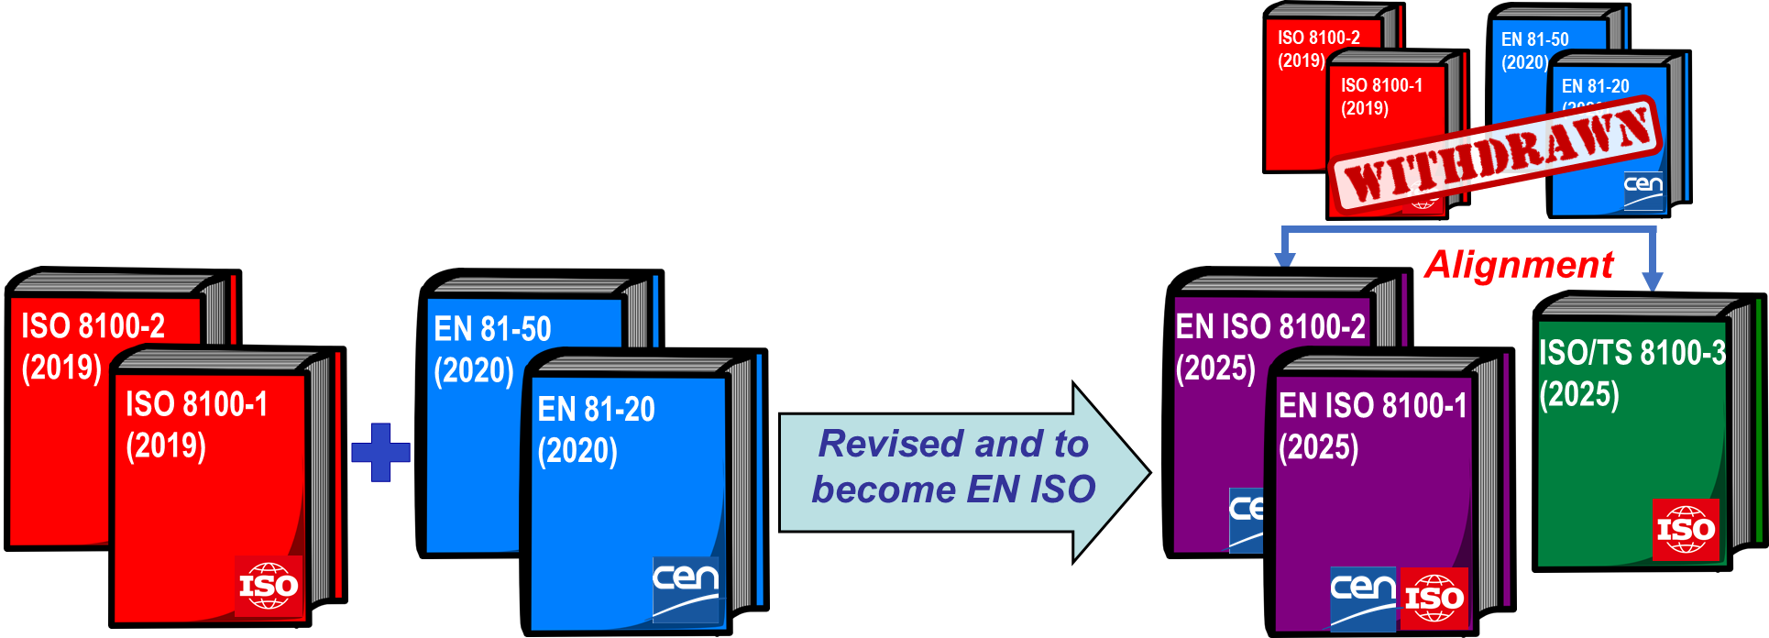
Worldwide convergence of technical requirements for safety of lifts Roadmap for (EN) ISO 8100-1/2
Roadmap: Agreed between members of ISO/TC 178 and CEN/TC 10
Objective: ISO standards for safety of lifts
Phase 1 (completed)
ISO adopted EN 81-20/50 as ISO 8100-1/2
EN 81-20/50:2020 and ISO 8100-1/2:2019 coexist
Phase 2 (on-going)
EN 81-20/50:2020 and ISO 8100-1/2:2019 are being revised
CEN is leading this project
Result will be published as ISO 8100-1/2:2025
CEN will adopt ISO 8100-1/2:2025 as EN ISO 8100-1/2:2025
EN 81-20/50:2020 will be withdrawn

Slide 10
EN ISO 8100-1/2

Slide 11
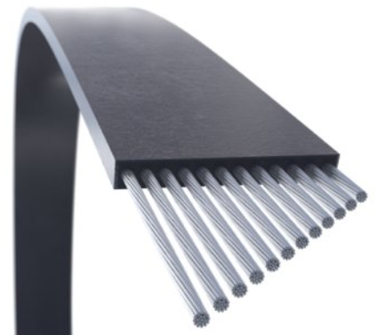
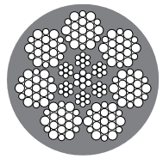
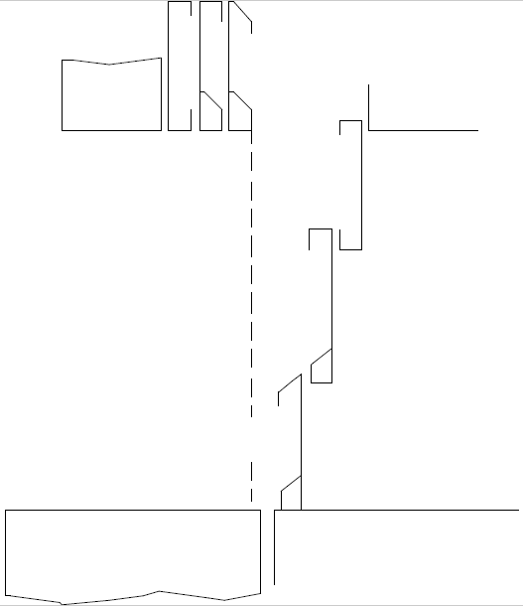
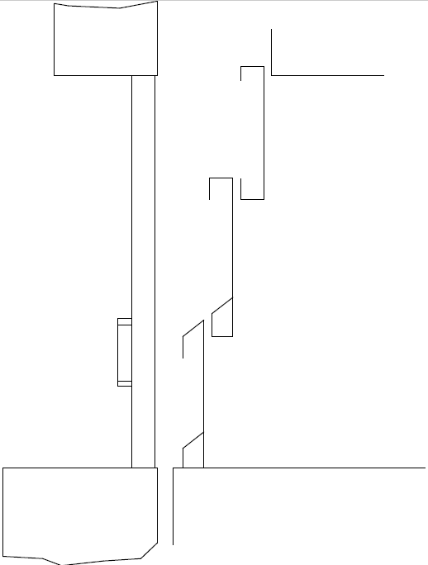
EN ISO 8100-1/2 Main technical changes
Inclusion of requirements for other means of suspension and their discard criteria
Steel ropes with
diameter 4 mm ≤ d ≤ 8 mm
Elastomeric coated traction belts
Elastomeric coated steel wire ropes
Inclusion of vertically sliding doors
Car door with combination landing swing door
Car and landing doors

Slide 12
EN ISO 8100-1/2 Main technical changes
Extension of reduced rated loads for hydraulic lifts to traction lifts
Allowing larger car floor area for a given rated load for traction lifts
Inclusion of working platform in the pit
A possible solution to avoid the need for pit access door for pits deeper than 2500mm
Enhancement of pit ladder requirements
Reducing the maximum allowed mass and reduction of distance from the landing door opening
Providing easier and safer access to pit ladder

Slide 13
EN ISO 8100-1/2 Main technical changes
Enhancement of requirements for machine brake
Improving requirements for manual brake release
Inclusion of hydraulic means for release of machine brake
Improving machine brake redundancy: in case of failure of one set of brakes, the rest of brake sets to decelerate the car with 110% loading
Improvement of brake control, for example safety related brake control shall fulfil safety circuit requirements
Improvement of brake self-monitoring, for example monitoring correct release of the brake or monitoring of braking force to detect impending failure of braking function
Enhancement of requirement for activation circuit of ACOP/UCMP when other than machine brake is used as stopping means

Slide 14
EN ISO 8100-1/2 Main technical changes
Making Emergency Terminal Speed Limiting (ETSL) as a safety device
ETSL checks on retardation in case of reduced stroke buffer as safety device
Considering not only detection (electric safety device) but also activation, braking and traction
Enhancing overload detection
Removing the 75 kg minimum limit
Reducing the tolerance from 10% to 2.5% (still under discussions)
Inclusion of cybersecurity
Making normative reference to ISO 8102-20 (under development)
Many other improvements, enhancement and clarifications based on
Interpretation requests and FAQs
Comments received from all stakeholders and users of EN 81-20/50 or ISO 8100-1/2

Slide 15
EN ISO 8100-1/2 Significant editorial improvements
Alignment of formulation of the requirements and structure of the standard
Full alignment with ISO Directive 2 (DIR2), and CEN International Regulation 3 (IR3) identical to ISO DIR2, to ensure their publication by CEN and ISO
Formulation of the requirement giving certainty in application
Requirement are made clear and verifiable, reducing different interpretations by different parties
Requirements of the standard do not impose any obligations to any specific party, e.g. manufacturer
Those obligations are generally defined by the national regulations.
Requirements of the standard are made neutral, from the regulatory framework point of view,
Do not impose requirements, for example for building construction, etc., which are covered by the national building codes
Do not contain conformity assessment procedures, as these are also covered by the national regulations

Slide 16
EN ISO 8100-1/2 Expected outcome
Revised standards reflect the current state-of-the art
Inclusion of the current technologies
Enhanced (safety) requirements
Significant improvement in formulation of the requirements
Requirements are formulated as verifiable requirements
Content and formulation of the standards are easier to be understood and the structure of the standard is organized in a logical order
Higher level of user friendliness
Fully in line with the most recent CEN and ISO rules for drafting international standards
The content of the standard is made neutral
Requirement are formulated independent of the regulatory framework, conformity assessment procedures or parties involved
Simplifies national adoption of the standards in different markets with diverse regulatory frameworks

Slide 17
ISO/TC 178 work program

Slide 18
ISO/TC 178 - Lifts, escalators and moving walks Structure of references
Series N° | Title | Remarks
8100 | Lifts for the transport of persons and goods | Parts of the series of standards for passenger and goods passenger lifts
8101 | Fire safety on lifts | Parts of the series of standards dealing with fire safety and emergency issues
8102 | Electrical requirements for lifts, escalators and moving walks | Parts of the series of standards dealing with electrical, electronic and electromagnetic compatibility issues for lifts, escalators and moving walks
8103 | Escalators and moving walks | Parts of the series of standards for escalators and moving walks
8104 | Improvement of safety on existing lifts & escalators | Parts of the series of standards for lifts & escalators specifying guidelines for the improvement of safety for existing units
8105 | Other lifting appliances or equipment | Parts of the series of standards for lifts other than described in series N° 8100

Slide 19
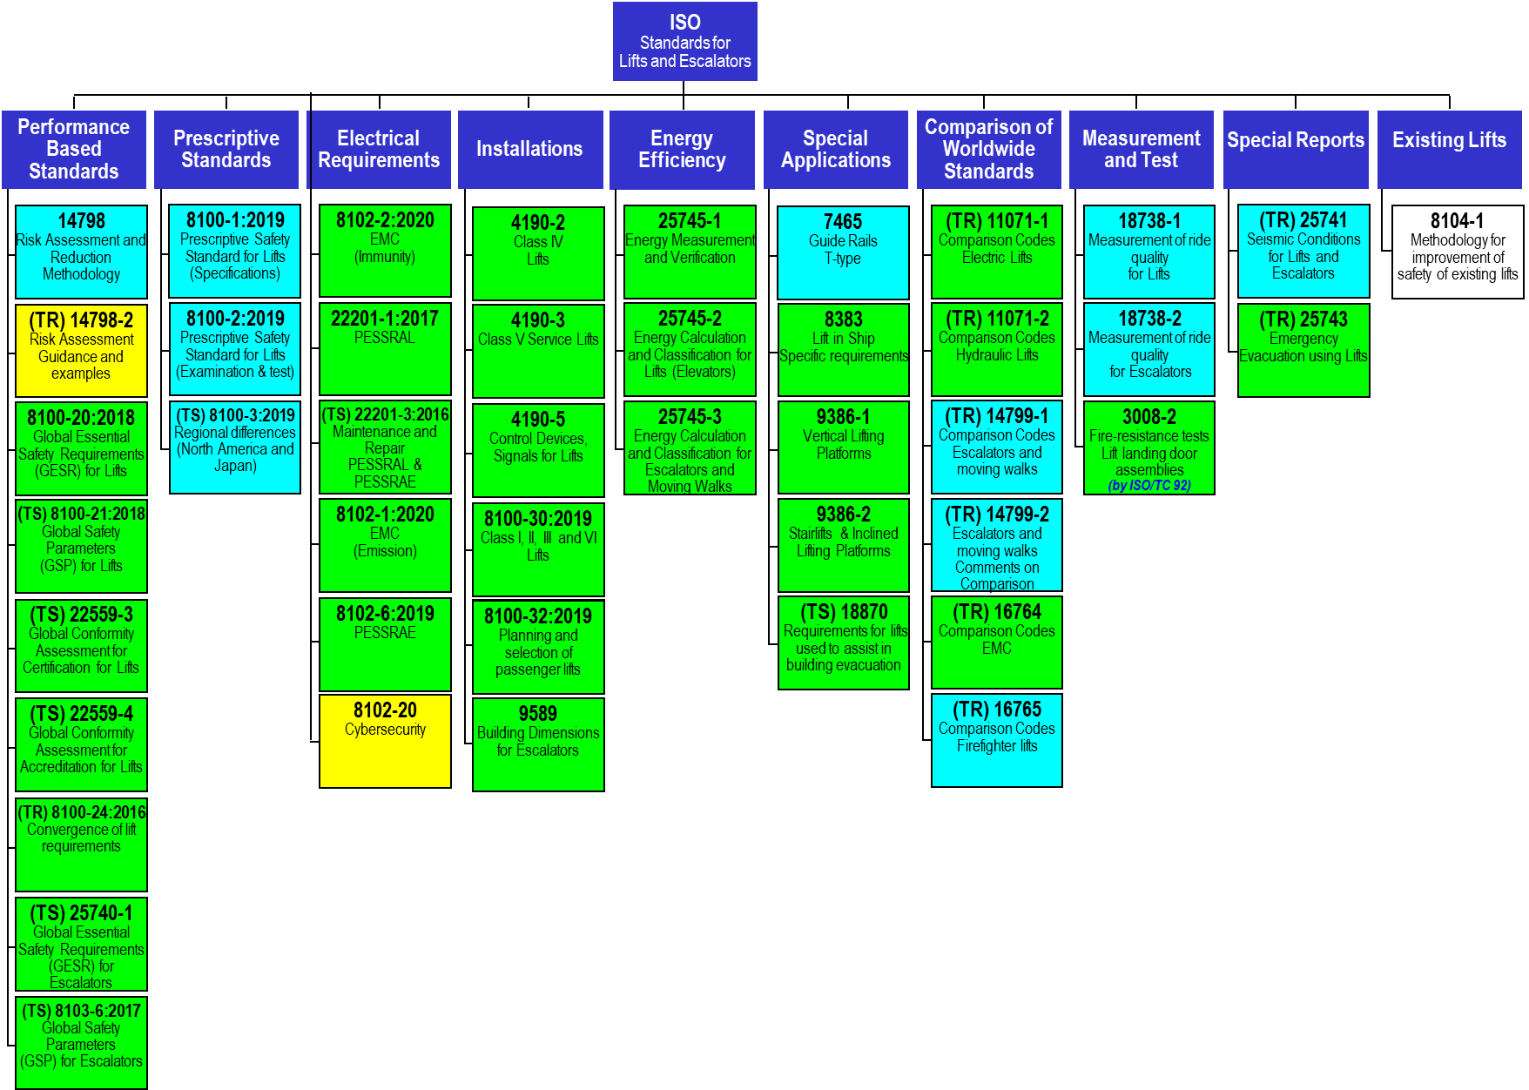
ISO/TC 178 - Lifts, escalators and moving walks General overview
Total of 43 standards, 41 published and 2 under development

Slide 20
Thank you!

